Slide 1
NFT Based Crypto Analysis (using Machine learning)

Slide 2
UNDER THE GUIDANCE: PRESENTED BY:
Prof. C. Deepa, M.Sc. MPhil. MBA., MA (Yoga), SANJAY. K,
Assistant Professor, 20MSS040,
Department of Software Systems, Department of Software Systems,
PSG College of Arts & Science, PSG College of Arts & Science,
Coimbatore. Coimbatore.

Slide 3
Abstract
In this project we attempt to implement ml approach to predict NFT based crypto( Dogecoin ).
The objective is to predict the Dogecoin price in order to make more informed and accurate investment decision.
autoTS is a very powerful automated machine learning algorithm which is used to predict values with higher accuracy from time to time.
The previous prices of Dogecoin is important because it is crucial to predict the future price of Dogecoin

Slide 4
Project Overview
In this project we attempt to implement ml approach to predict NFT based crypto (Dogecoin).The objective is to predict the Dogecoin price in order to make more informed and accurate investment decision. AutoTS is a very powerful automated machine learning algorithm which is used to predict values with higher accuracy from time to time. The previous prices of Dogecoin is important because it is crucial to predict the future price of Dogecoin.
This project mainly focus on helping the data analyst and business people to make business decisions. Initially this project displays the price prediction values of Dogecoin which was made with the inspiration of a very famous NFT (Non Fungible Token) known as Shiba Inu which represents a particular breed of dog. Crypto currency is a type of digital currency similar to dollars, euros, and yen. The difference is that instead of the backing of a nation or federal bank, it uses an online ledger with strong cryptography to secure online transactions.
Through crypto currency exchanges, one can buy and sell crypto currencies. It can also be “mined.” The popularity of crypto currencies skyrocketed in 2017 as a result of several months of exponential growth in their market capitalization. Using machine learning, this program helps in forecasting crypto currency prices. This system is adequate to aid in price prediction, and the results obtained from predicting prices using machine learning achieve accuracy under all circumstances of technical trade indication, lowering its price prediction during evaluation

Slide 5
Existing System
The existing system uses machine learning models which produces less accuracy
The existing system cannot deal with NaN values or it should be cleared manually.
It takes more time to process the output
Proposed System
The working of the model is done by autoTS which deals with the NaN values easily
It produces better accuracy than other models
The autoTS machine learning algorithm takes less time to process the output.
It supports multivariate outputs

Slide 6
Hardware Specifications
Component Minimum Requirement
PROCESSOR 1.6GHz or faster processor
MOTHERBOARD Intel 915GV chipset board
RAM 4 GB
DISK SPACE 512 GB
KEYBOARD 104 Keys Standard
MOUSE Optical Mouse
MONITOR Coloured Monitor

Slide 7
Software Specifications
Component Minimum Requirement
OPERATING SYSTEM Windows 7 or Above
DEVELOPMENT TOOL VS Code Editor
WEB BROWSER Google Chrome
TERMINAL Python

Slide 8
Module Specification
User
Collection Of Data
Preprocessing
Splitting Dataset Into Training And Testing
Module Description
USER
In user module any user can access the project. It consists of a saved model where the users can access the predicted values using AutoTS machine learning python package

Slide 9
COLLECTION OF DATA
In this module, we will be collecting dataset from various platforms like kaggle.com, data.world, lionbridge.ai etc. and merging the small datasets to create one large dataset
PREPROCESSING
In this module, the dataset are cleaned and reduced in size by deleting the values that are not required for our machine learning model and the values with NULL and NaN (Not a Number) values are ignored so that the machine learning model can run without errors
SPLITTING DATASET INTO TRAINING AND TESTING
In this module, the dataset is divided into training dataset and testing dataset. The training and testing dataset are splitted automatically by AutoTS machine learning algorithm

Slide 10
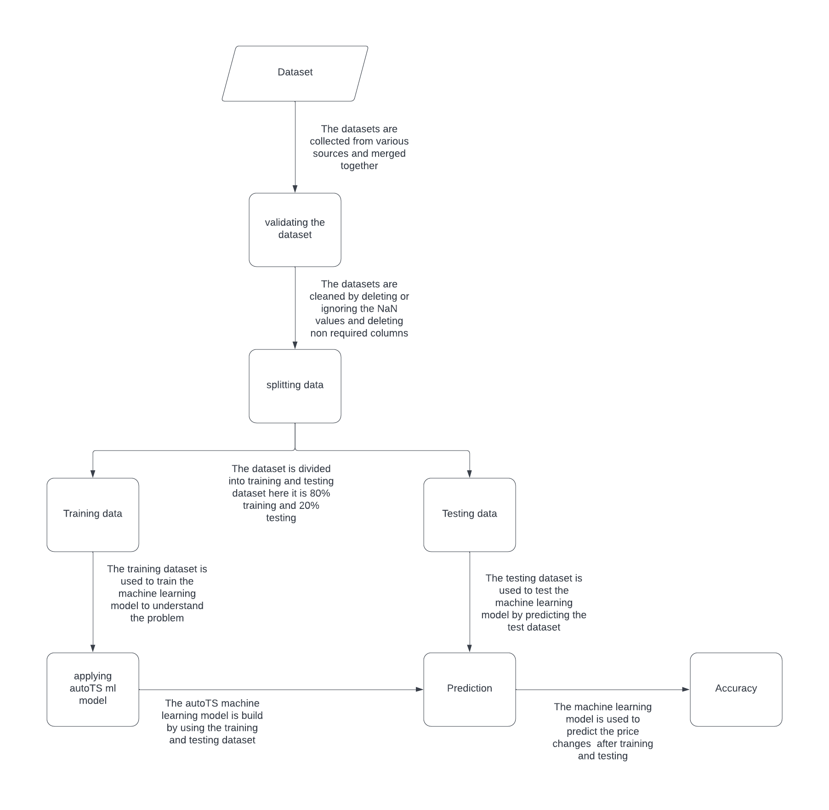
System Flow Diagram

Slide 11
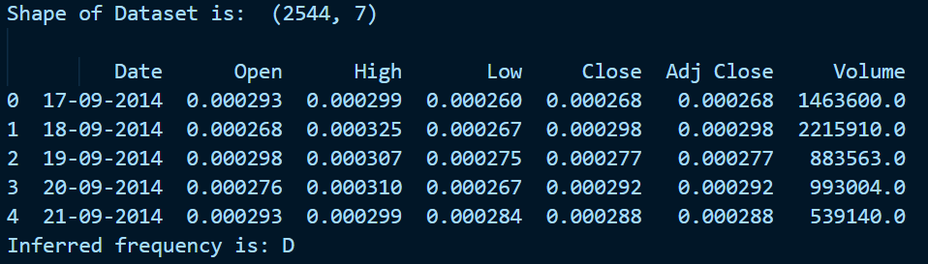
Screenshots

Slide 12
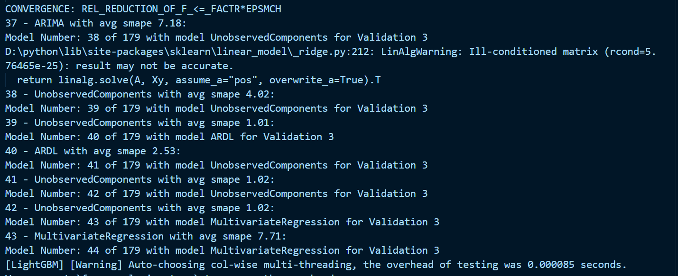

Slide 13
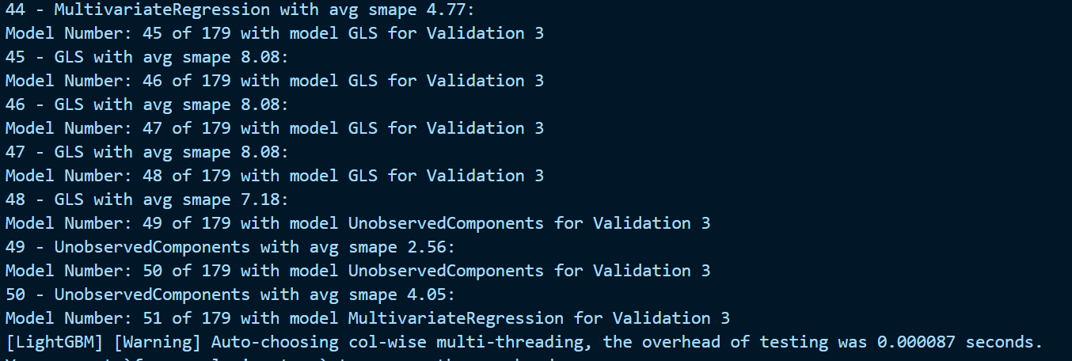

Slide 14
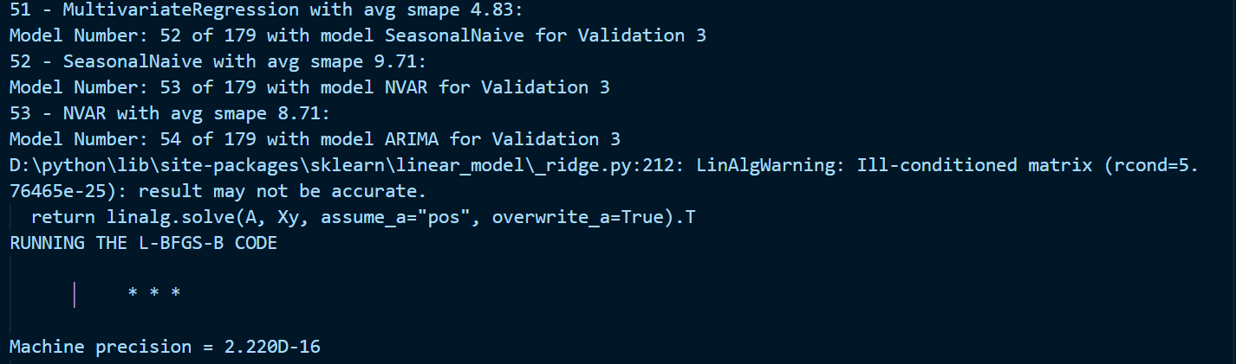

Slide 15
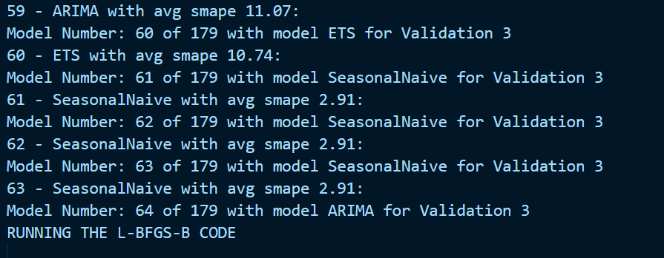

Slide 16
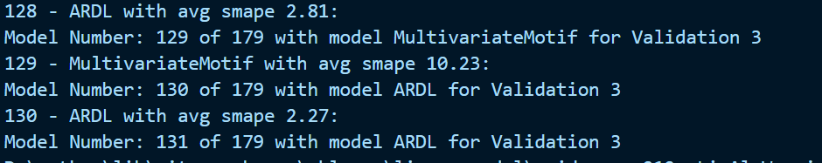

Slide 17
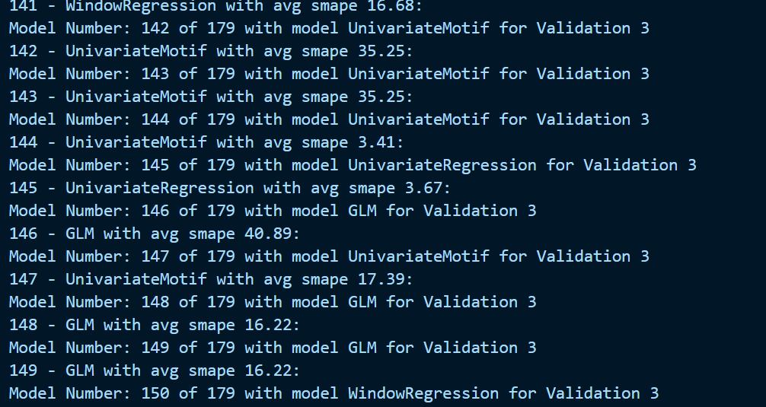

Slide 18
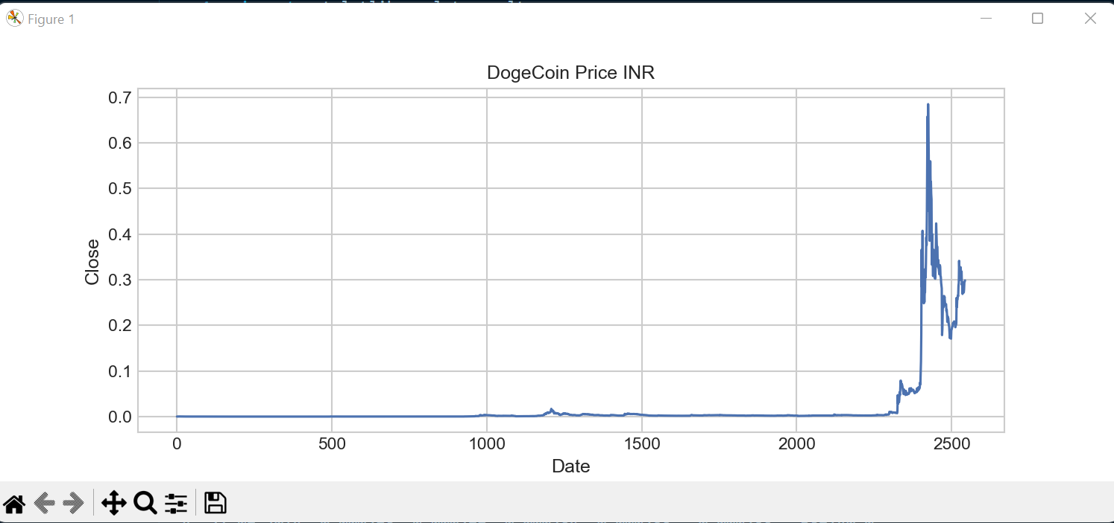
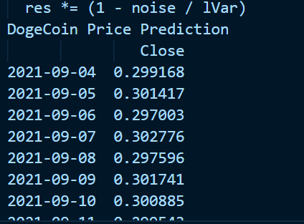

Slide 19
Scope For Future Enhancement
The project has covered almost all the requirements. Further requirements and improvements can easily be done since the coding is mainly structured or modular in nature. Improvements can be appended by changing the existing modules or configuring the existing modules.
The purpose of this project is to predict the price of the Crypto currency or token based on the dataset provided by various resources such as kaggle, lionsdataset etc. Here we take a medium sized dataset for prediction and analysis. In future we may collect a better dataset or create a better dataset and we will predict the patterns and price with the help of other new machine learning algorithms.
The user interface of the project can be improved for better user interaction and easy understandability. This project can offer other big crypto predictions such as Etherium, Bitcoin, and BNB etc. The functionality of the project can be improved so that the users can access the project easily. Using more granular data such as data of every day, every minute, and every second can improve accuracy of prediction as it contains more insightful information than one day data.
Future work contains providing predictions and recommendations for individuals according to their risk and reward appetite, and also providing a portfolio management to mitigate the risk associated with investing in stock market.
The Algorithm used in this project can be optimized by configuring the algorithm to run at very low time than the existing algorithm and the space used by algorithm can be minimized by efficiently running the machine learning model.
Multiple inputs can be introduced to predict the prices with particular parameters and the previous data can be stored in the database for future references and predictions. The functionality in the machine learning model can be improved.

Slide 20
Conclusion
It is concluded that the NFT based Crypto Analysis works well and satisfy the users in viewing prices predicted by the machine learning model. This project is developed using HTML, CSS, Python, Flask and Machine Learning. The user interface of the project is simple and easily understandable.
The project work well in both mobile device and desktop devices to have better user experience. The framework gives many price information’s to the data analysts and investors. This portal will serve the cause of knowledge gathering for all the data analysts as well as the investors. All required testing is done to make the user have better experience using this framework. The project helps the data analyst and the investors in all possible ways to grew better by following the results provided by the project. In this model, it helps to analyze the growth of the companies from different sectors and try to find out which is the best time span for the best value to buy crypto currency.
So, this draws an important conclusion that companies from a certain sector have the same dependencies as well as the same growth rate. The prediction can be more accurate if the model is trained with a greater number of datasets. This framework broadly helps in market analysis and prediction of growth of Dogecoin in different time spans.
I can’t promise you that everyone of your moves in this market will be successful, only because you copy these steps but take this model as a guide or map to find your own way of researching crypto, and if you do so on a constant basis and with a lot of effort and discipline, I promise you, the number of successful investment will increase.

Slide 21
Thank You

